Slide 1
Software Quality Management
Software Engineering

Slide 2
What is Quality Management?
Managing the quality of the
software process and products

Slide 3
Objectives
To introduce the quality management process and key quality management activities
To explain the role of standards in quality management
To explain the relationship between quality attributes and software metrics
To explain how measurement may be used in assessing software quality

Slide 4
Software quality management
Concerned with ensuring that the required level of quality is achieved in a software product
Involves defining appropriate quality standards and procedures and ensuring that these are followed
Should aim to develop a ‘quality culture’ where quality is seen as everyone’s responsibility

Slide 5
What is quality?
Quality, simplistically, means that a product should meet its specification
This is problematical for software systems
  Tension between customer quality requirements (efficiency, reliability, etc.) and developer quality requirements (maintainability, reusability, etc.)
  Some quality requirements are difficult to specify in an unambiguous way
  Software specifications are usually incomplete and often inconsistent

Slide 6
Software quality attributes
Portability
Usability
Reusability
Maintainability
Understandability
Efficiency
Reliability

Slide 7
A high quality software product …
Satisfies clearly stated requirements
Checks its inputs and that it reacts in predictable ways to illegal inputs
Has been inspected thoroughly by others
Has been tested exhaustively by others
Is thoroughly documented
Has a known defect rate

Slide 8
The quality compromise
We cannot wait for specifications to improve before paying attention to quality management
Must put procedures into place to improve quality in spite of imperfect specification
Quality management is therefore not just concerned with reducing defects but also with other product qualities

Slide 9
1. Specify how to manage
project documents
2. Identify process
1. QA Develops
and/or reviews
configuration
management
plans, standards ...
Quality Planning
2. QA reviews
process for
conformance to
organizational
policy
QM should have
some independence
from PM
QA
Quality Control
3. QA develops
and/or reviews
provision for
QA activities
5. QA reviews,
inspects & tests
4. QA reviews,
inspects & tests
5. Deliver & main-
tain the product
4. Design and build
3. Plan
Adapted from Software Engineering: An Object-Oriented Perspective by Eric J. Braude (Wiley 2001), with permission.

Slide 10
Quality management activities
Quality assurance
  Establish organisational procedures and standards for quality
Quality planning
  Select applicable procedures and standards for a particular project and modify these as required
Quality control
  Ensure that procedures and standards are followed by the software development team
Quality management should be separate from project management to ensure independence

Slide 11
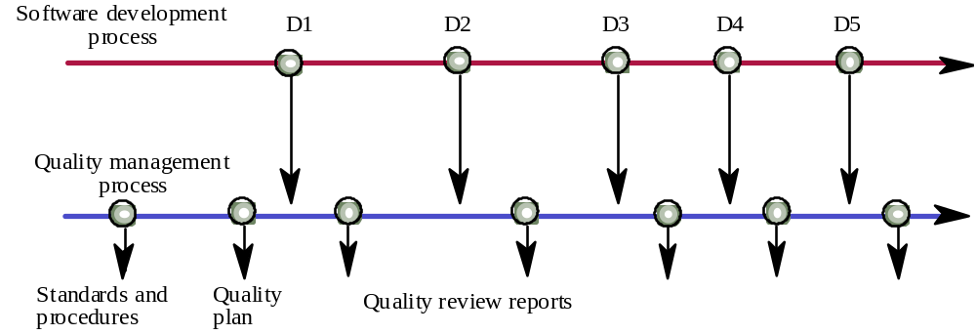
Quality management and software development

Slide 12
Quality assurance and standards
Standards are the key to effective quality management
They may be international, national, organizational or project standards
Product standards define characteristics that all components should exhibit e.g. a common programming style
Process standards define how the software process should be enacted

Slide 13
Importance of standards
Encapsulation of best practice- avoids
repetition of past mistakes
Framework for quality assurance process –
it involves checking standard compliance
Provide continuity - new staff can understand
the organisation by understand the standards
applied

Slide 14
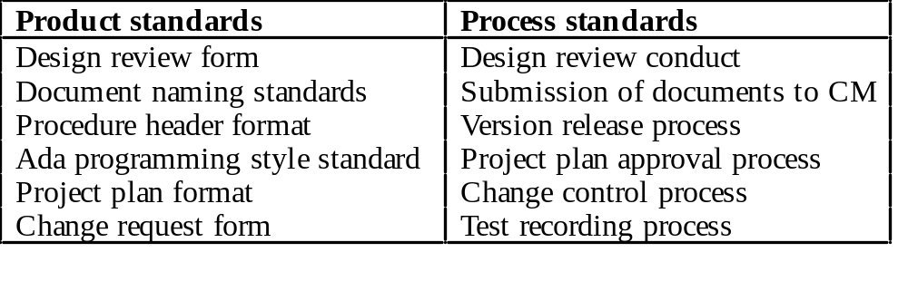
Product and process standards

Slide 15
ISO 9000
International set of standards for quality management
Applicable to a range of organisations from manufacturing to service industries
ISO 9001 applicable to organisations which design, develop and maintain products
ISO 9001 is a generic model of the quality process that must be instantiated for each organisation

Slide 16
ISO 9000 certification
Quality standards and procedures should be documented in an organisational quality manual
External body may certify that an organisation’s quality manual conforms to ISO 9000 standards
Customers are, increasingly, demanding that suppliers are ISO 9000 certified

Slide 17
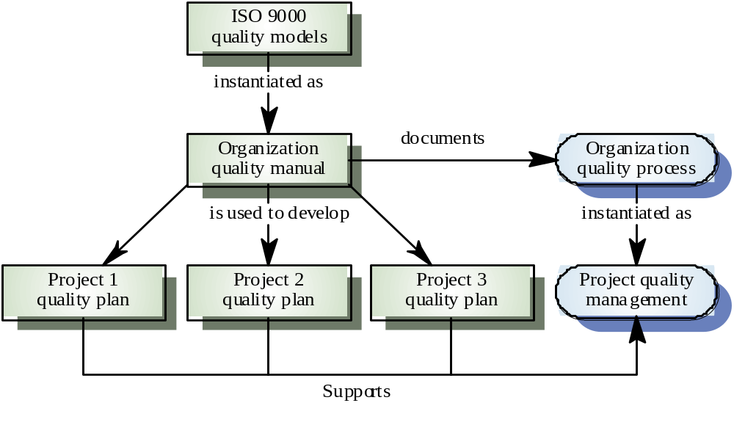
ISO 9000 and quality management

Slide 18
Problems with standards
Not seen as relevant and up-to-date by software engineers
Involve too much bureaucratic form filling
Unsupported by software tools so tedious manual work is involved to maintain standards

Slide 19
Overcoming the Problems
Involve practitioners in development. Engineers should understand the rationale underlying a standard
Review standards and their usage regularly.
Standards can quickly become outdated and this reduces their credibility amongst practitioners
Detailed standards should have associated tool
support. Excessive clerical work is the most
significant complaint against standards

Slide 20
Process and product quality
The quality of a developed product is influenced by the quality of the production process
Form (product) follows function (process)
Particularly important in software development as some product quality attributes are hard to assess
However, there is a very complex and poorly understood relationship between software processes and product quality

Slide 21
Process-based quality
Straightforward link between process and product in manufactured goods
More complex for software because:
  The application of individual skills and experience is particularly imporant in software development
  External factors such as the novelty of an application or the need for an accelerated development schedule may impair product quality
Care must be taken not to impose inappropriate process standards

Slide 22
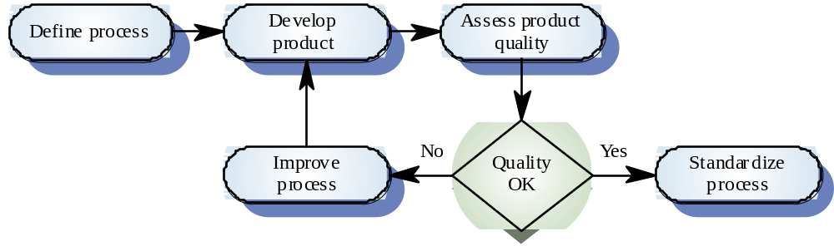
Process-based quality

Slide 23
Practical process quality
Define process standards such as how reviews
should be conducted, configuration
management, etc.
Monitor the development process to ensure
that standards are being followed
Report on the process to project management
and software procurer

Slide 24
Quality planning
A quality plan sets out the desired product qualities and how these are assessed and
define the most significant quality attributes
It should define the quality assessment process
It should set out which organisational standards should be applied and, if necessary, define new standards

Slide 25
Quality plan structure
Product introduction
Product plans
Process descriptions
Quality goals
Risks and risk management
Quality plans should be short, succinct documents
  If they are too long, no-one will read them

Slide 26
IEEE 730-1989 Software Quality Assurance Plans
Table of Contents
1. Purpose
2. Referenced documents
3. Management
3.1 Organization
3.2 Tasks
3.3 Responsibilities
4. Documentation
4.1 Purpose
4.2 Minimum documen-
tation requirements
4.3 Other
5. Standards, practices, conventions and metrics
5.1 Purpose
5.2 Content
6. Reviews and audits
6.1 Purpose
6.2 Minimum requirements
6.2.1 Software requirements
review
6.2.2 Preliminary design review
6.2.3 Critical design review
6.2.4 SVVP review
6.2.5 Functional audit
6.2.6 Physical audit
6.2.7 In-process audits
6.2.8 Managerial review
6.2.9 SCMP review
6.2.10 Post mortem review
6.3 Other

Slide 27
IEEE 730-1989 Software Quality Assurance Plans
Table of Contents
7. Testing
8. Problem Reporting and Corrective Action
9. Tools, Techniques and Methodologies
10. Code Control
11. Media Control
12. Supplier Control
13. Records Collection, Maintenance and Retention
14. Training
15. Risk Management

Slide 28
Quality control
Checking the software development process to ensure that procedures and standards are being followed
Two approaches to quality control
  Quality reviews
  Assessment via software metrics

Slide 29
Quality reviews
The principal method of validating the quality of a process or of a product
Group examines part or all of a process or system and its documentation to find potential problems
There are different types of review with different objectives
  Inspections for defect removal (product)
  Reviews for progress assessment(product and process)
  Quality reviews (product and standards)

Slide 30
Workshop - A Quality Challenge
Using 5 Cards and 2 pieces of tape construct a platform which can withstand the repeated drop (3 times) of a pack of post-it notes from 1 inch
The end product must:
  Be at least one card high
  Not have any folded cards
  Make efficient use of resources (minimize where possible)
  Be portable
The end product should be of high quality:
  Extensible (capable of enhancement)
  Adaptable (capable requirements change)
  Portable (applicable to several environments)
  Reusable (applicable to different situations)

Slide 31
Team Work (4 people)
Quality assurance person / tester
Requirements analyst
Designer
Developer

Slide 32
Quality attributes and software metrics
Software measurement is concerned with deriving a numeric value for an attribute of a software product or process
Software metric is any type of measurement which relates to a software system, process or related documentation
This allows for objective comparisons between techniques and processes
There are few standards, no systematic use

Slide 33
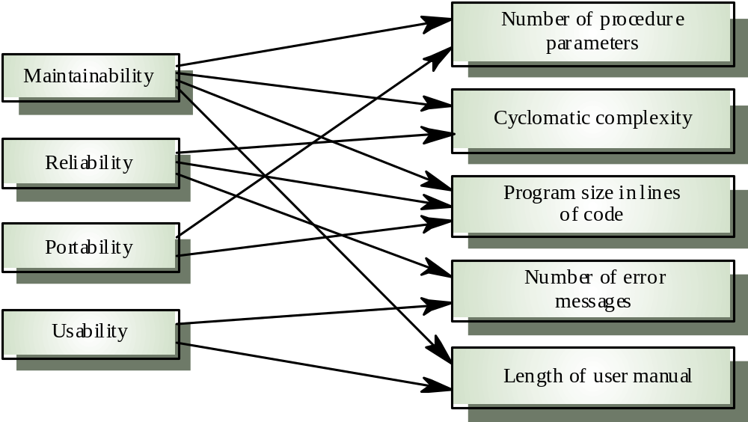
Quality attributes and software metrics

Slide 34
Important software metric assumptions
A software property can be measured
A relationship exists between what we can measure and a quality attribute
This relationship has been formalized and validated

Slide 35
The measurement process
A software measurement process may be part of a quality control process
Data collected during this process should be maintained as an organisational resource
Once a measurement database has been established, comparisons across projects become possible

Slide 36
Product metrics
A quality metric should be a predictor of
product quality
Classes of product metric
  Dynamic metrics which are collected by measurements made of a program in execution
  Static metrics which are collected by measurements made of the system representations
  Dynamic metrics help assess efficiency and reliability; static metrics help assess complexity, understandability and maintainability

Slide 37
Dynamic and static metrics
Dynamic metrics are closely related to software quality attributes
  Collected by a program in execution (response time, number of failures)
  Help assess efficiency, effectiveness, availability and reliability
Static metrics have an indirect relationship with quality attributes
  Collected from system representation (lines of code)
  Help assess complexity, understandability and maintainability

Slide 38
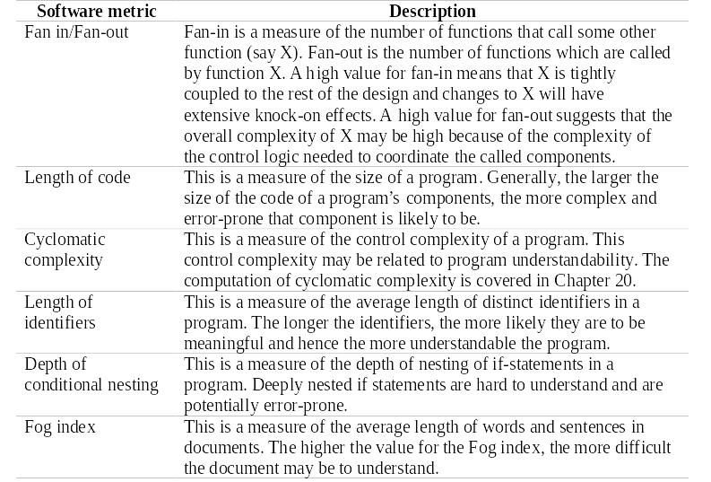
Software product metrics

Slide 39
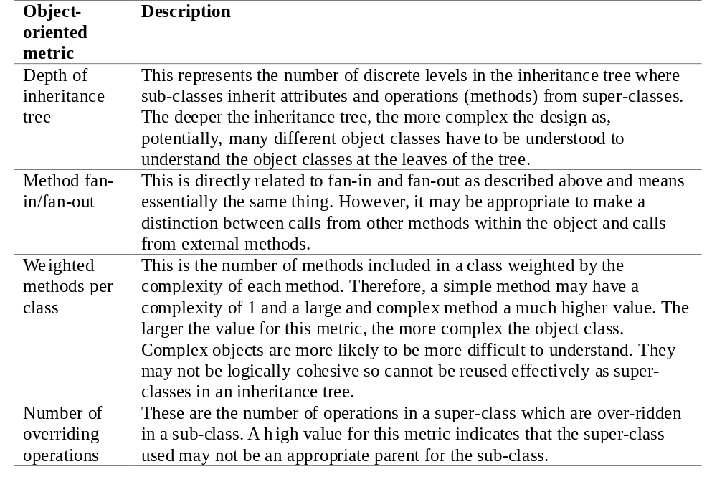
Object-oriented metrics

